Slide 1
Chapter 10: Link Layer
CS433 เครือข่ายคอมพิวเตอร์

Slide 2
Outline
Introduction
Error Detection, Correction
Multiple Access Protocols
LANs
Link Virtualization: MPLS
Data Center Networking

Slide 3
Terminology
Nodes: Hosts, Routers
Links: Wired Links, Wireless Links
Frame: Layer-2 Packets (Encapsulate Datagrams)

Slide 4
Link Layer
Datagram travel over different links
e.g. sent from 802.11 (Wireless) to AP, AP send to its intermediate links on Ethernet, then send out using Frame Relay
Each link protocol may provide different services
e.g. Some may not provide RDT

Slide 5
Link Layer Services
Transferring Datagram from one node to physically adjacent node
Framing Datagram
Link Access: Medium Access Control (MAC)
Reliable Delivery between adjacent nodes: RDT, use on wireless links

Slide 6
Link Layer Services
Flow Control
Pacing control between adjacent sending and receiving nodes
Error Detection
Error from noise, signal attenuation then drop error frame
Error Correction
Receivers correct bit errors without retransmission
Half-duplex vs Full-duplex
nodes at both ends can transmit but not at the same time

Slide 7
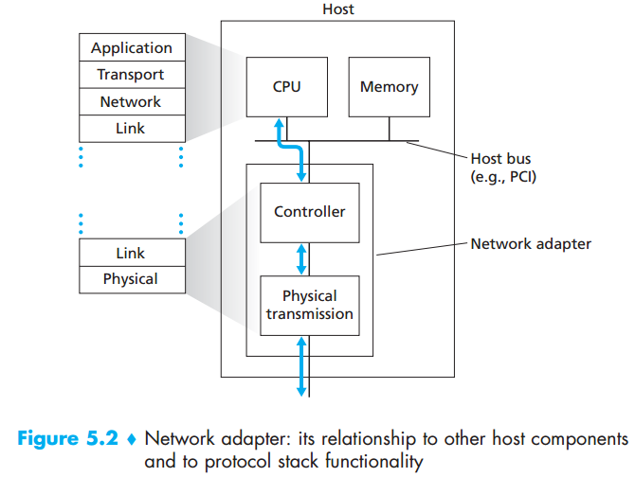
Link Layer Implementation
In each host
In adaptor (NIC) or network chip
Ethernet card, 802.11 card
Attaches into host’s system buses
Combination of hardware, software, firmware

Slide 8
Adaptors Communicating
Sender
Encapsulate datagram
RDT, flow control
Receiver
Error checking, RDT, flow control
Decapsulate
Pass datagram to upper layer
Sender
Receiver

Slide 9
Outline
Introduction
Error Detection, Correction
Multiple Access Protocols
LANs
Link Virtualization: MPLS
Data Center Networking

Slide 10
Error Detection
D: Data
EDC: Error Detection and Correction bits
*Error detection not 100% reliable
**Larger EDC = better detection

Slide 11
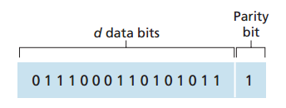
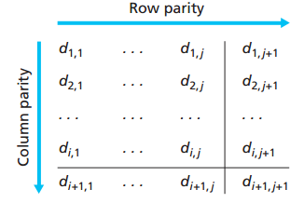
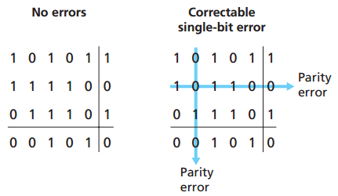
Parity Checking
Single bit parity
Two-dimensional
bit parity
Detect and correct single bit errors

Slide 12
Internet Checksum
Transport Layer Checksum
Checksum of the whole segment (header+data)
Network Layer Checksum
Checksum of the IP header only
Link Layer Checksum?
Cyclic Redundancy Check (CRC)

Slide 13
Cyclic Redundancy Check (CRC)
More powerful than checksum
Widely used in practice (Ethernet, 802.11, ATM)
Given D as data, G as generator and R is CRC-bits
<D, R> divide by G (mod 2), if the result has non-zero bit => Error
D: Data bits to be sent
R: CRC bits
d bits
r bits

Slide 14
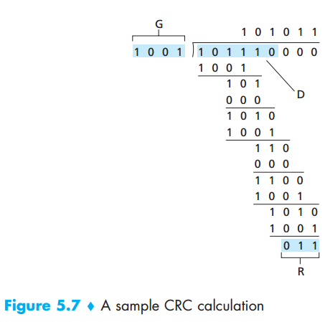

CRC Example
ถ้าขนาดของ CRC มี n ตัว
ให้เติม 0 เป็นจำนวน n ตัวหลังข้อมูลที่ต้องการจะหาค่า CRC
D = 101110000
G = 1001
R = $\frac{D{∙2}^{r}}{G}$ = 011
XOR กัน

Slide 15
Outline
Introduction
Error Detection, Correction
Multiple Access Protocols
LANs
Link Virtualization: MPLS
Data Center Networking

Slide 16
Multiple access links
Two types of links
Point-to-point (PPP)
PPP for dial-up access
Point-to-point links between Ethernet switch and host
Broadcast
Ethernet hub
802.11 WiFi

Slide 17
Multiple Access Protocols
Single shared broadcast channel
Two or more simultaneous transmission
Interference (Collision) -> Error
Multiple access protocol: algorithm determines how nodes share channel
No additional channel for coordination

Slide 18
Ideal Multiple Access Protocol
Given channel of rate R bps
Only 1 node transmit, the node can transmit at rate R
M nodes transmit, each node can transmit at rate R/M
Decentralized: no manager node, no clock synchronization
Simple

Slide 19
Class of MAC Protocols
Channel Partitioning
divide channel into smaller slot (e.g. time slot, frequency)
then allocate each slot to node
Random Access
Allow collisions
Then recover from collisions
Taking turns
Nodes take turns
node with more to send taking longer turns

Slide 20
Channel Partitioning - TDMA
Time Division Multiple Access (TDMA)
hosts get fixed length slot to send (Packet transmission time)
Unused slot go idle (wasted bandwidth)
Example: 4 slot TDMA, and host 1, 3, 4 sending
4 slot frame
4 slot frame
4 slot frame
1
3
4
1
3
4
1
3
4
Time

Slide 21
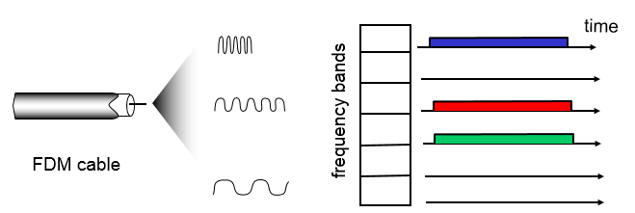
Channel Partitioning - FDMA
Frequency Division Multiple Access (FDMA)
hosts get their own fixed frequency bands

Slide 22
Random Access Protocols
If you want to send, just send
But if two or more nodes transmitting at the same time -> Collision
Random Access Protocol:
detect collisions
recover from collisions (e.g. delayed retransmission)
Example protocols
Slotted ALOHA, ALOHA
CSMA, CSMA/CD, CSMA/CA

Slide 23
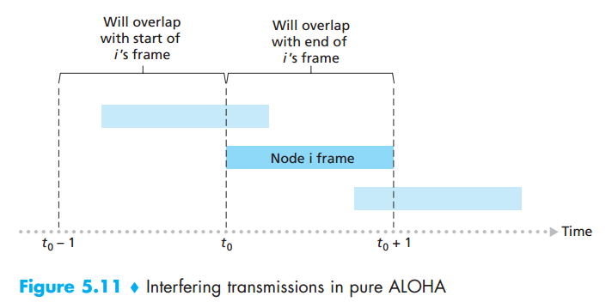
ALOHA
No slot, fully decentralized

Slide 24
Slotted ALOHA
All frames same size
Time divided into equal size slots
Nodes start to transmit only slot beginning
Nodes are synchronized
2 or more transmit at the same slot (same time), all node detect collision

Slide 25
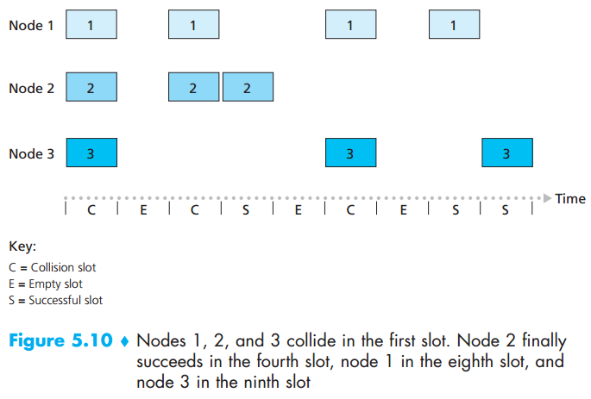
Slotted ALOHA

Slide 26
Slotted ALOHA
When nodes obtains new frame, transmits in next slot
If no collision: node sends new frame in next slot
If collision: node retransmits frame in each subsequent slot with probability p until success

Slide 27
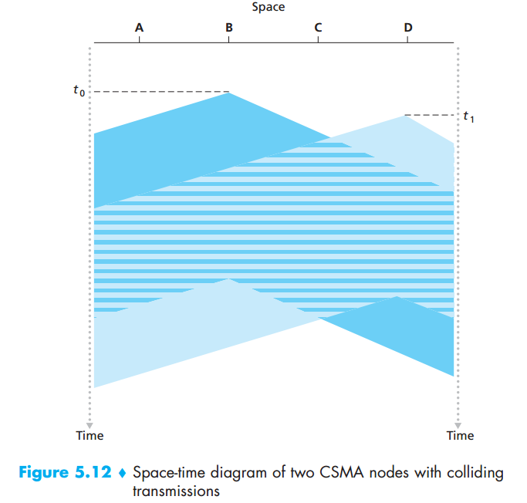
Carrier Sense Multiple Access (CSMA)
Listen before transmission
If channel is idle, transmit the full packet
If not idle, wait
Collision still occur
At the time or listening, channel is idle, but because of the propagation delay, node may not hear
distance, propagation delay

Slide 28
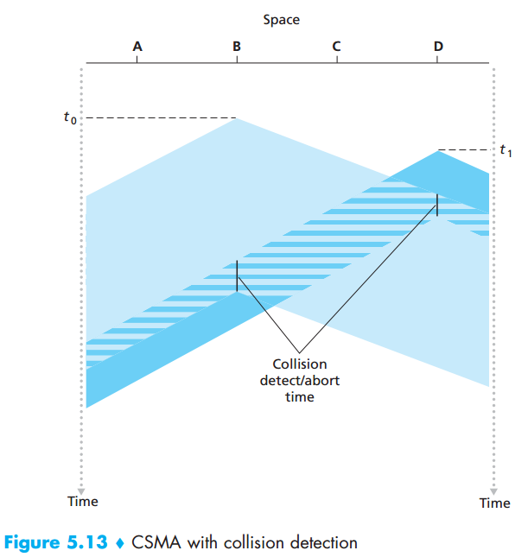
CSMA/CD
Collision Detection (CD)
Once notice collision, stop transmission
In Wired: detect by signal strength compare with transmission power

Slide 29
Ethernet CSMA/CD
NIC received datagram from Network Layer
If NIC senses channel idle, start frame transmission,
or if NIC senses channel is busy, delay the transmission.
If NIC transmits frame without detecting collision, job done.
4. but if NIC detects collision, aborts the transmission and send jam signal
After aborting, NIC enter binary (exponential) backoff
Mth collision, NIC chooses K at random from {0,1,2, …, 2^{m}-1} and wait for K x 512 bit times, then goes back to Step 2
More Collision = Longer Backoff

Slide 30
Taking Turns
Channel Partitioning
High load -> Efficient
Low load -> Inefficient, delay in channel access 1/N bandwidth
Random Access
Low load -> Efficient
High load -> Collision overheads
Taking turns?

Slide 31
Polling protocol: Taking turns
Having Master node and Slave nodes
Master node invites slave to transmit in turn
Concerns: polling overheads, latency, single point of failure (at master node)
Practical use in Bluetooth
Data
Slave node
Poll
Master node
Data
Slave node
Data
Slave node

Slide 32
Token passing: Taking turns
Token: node, which controls token, can transmit upto n datagrams then pass the token message to the next node.
Token message will be passed in order manner
Concerns: Token overheads, latency and token lost? What to do?
Data
Token
Data
Data
Data

Slide 33
Summary of MAC
Channel Partitioning
Time Division, Frequency Division
Random Access
ALOHA, S-ALOHA
CSMA/CD (Ethernet), CSMA/CA (802.11)
Taking Turns
Polling, Token Ring

Slide 34
Outline
Introduction
Error Detection, Correction
Multiple Access Protocols
LANs
Link Virtualization: MPLS
Data Center Networking

Slide 35
LANs
Addressing
ARP
MAC
Ethernet
Switches
VLANs

Slide 36
Addressing
IP address 32bit
Network layer address for interface
Used for Network Layer (Layer 3) forwarding
MAC address (Physical address)
Used to get frame from one interface to another physically-connected interface (in the same IP network)
48 bit MAC address burned in to NIC ROM
e.g. 1A-2F-BB-76-09-AD (in hex code - 4bit each)

Slide 37
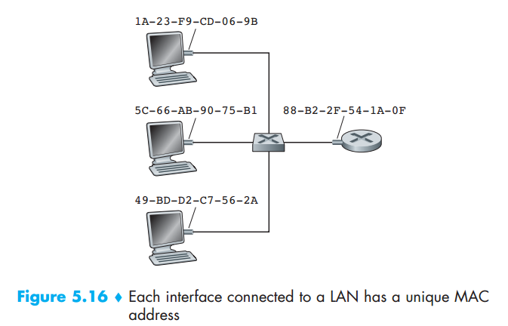
MAC Address
Each NIC has unique MAC address
Links can be either
wired or wireless

Slide 38
MAC addresses
MAC addresses (Physical or LAN address) are allocated by IEEE
Manufacturer buys portion of MAC address
Analogy:
MAC address: national ID
IP: postal address

Slide 39
ARP: Address Resolution Protocol
mapping: MAC address and IP address.
ARP table contains each pair of IP and MAC addresses for each node along with TTL
TTL: Time to live is a time after address will be forgotten. Typically remember for 20 mins
IP Address | MAC Address | TTL
192.168.1.15 | 1A:2D:3C:FF:AB:3D | 17:50:10
192.168.1.55 | 3D:4F:AA:20:1C:40 | 09:14:02
ARP Table

Slide 40
ARP Protocols
A wants to send datagram to B
A’s ARP table doesn’t have B’s MAC address
A broadcast ARP query packet, containing B’s IP
B receives ARP query, then reply A with its MAC
A receives B’s MAC address then save into its ARP table.
ARP is “Plug-and-play”, nodes create their ARP table when join networks themselves
***When nodes join network, nodes get IP using DHCP, then use ARP to get MAC***

Slide 41
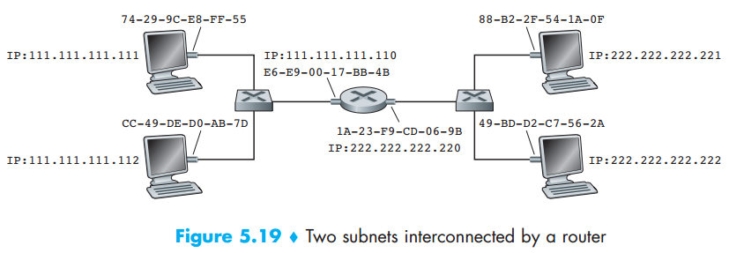
Sending Datagram from A to B
Assume A got B’s IP address
How A knows R’IP and R’s MAC address?
Node A
Node B
Router R

Slide 42
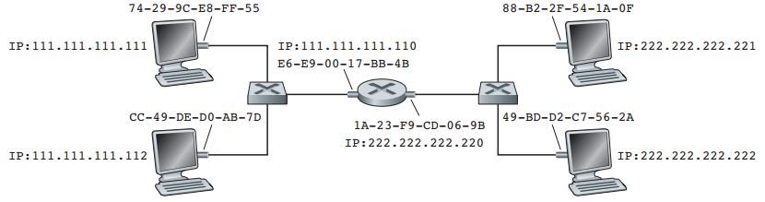
Sending datagram A to B
A create IP datagram with IP Src of A, IP Dst of B
Create Link Layer frame with R’s MAC as Dst
MAC Src: 74-29-9C-E8-FF-55
MAC Dst: E6-E9-00-17-BB-4B
IP Src: 111.111.111.111
IP Dst: 222.222.222.221
Segment
Node A
Node B
Router R

Slide 43
Sending datagram A to B
Frame sent from A to R
R received the frame, remove link layer header, pass it up to network layer
MAC Src: 74-29-9C-E8-FF-55
MAC Dst: E6-E9-00-17-BB-4B
IP Src: 111.111.111.111
IP Dst: 222.222.222.221
Segment
Node A
Node B
Router R

Slide 44
Sending datagram A to B
R forwards datagram with IP src A, dst B
R create link layer frame with B’s MAC as dst
MAC Src: 1A-23-F9-CD-06-9B
MAC Dst: 88-B2-2F-54-1A-0F
IP Src: 111.111.111.111
IP Dst: 222.222.222.221
Segment
Node A
Node B
Router R

Slide 45
Sending datagram A to B
R forwards datagram with IP src A, dst B
R create link layer frame with B’s MAC as dst
MAC Src: 1A-23-F9-CD-06-9B
MAC Dst: 88-B2-2F-54-1A-0F
IP Src: 111.111.111.111
IP Dst: 222.222.222.221
Segment
Node A
Node B
Router R

Slide 46
Chapter 10 Summary
Link Layer Introduction
Error Detection, Correction: Checksum, CRC
MAC: ALOHA, CSMA/CD
LAN: Addressing, ARP

Slide 47
ARP Spoofing
A
Internet
Router/Gateway
Switch
B
(2) R1->C
MAC Address ของ R1 คือ
AB:CD:01:02:…
C->Broadcast
ใครมี MAC address
ชอง Gateway R1 มั่ง
C
(3) C อัพเดต ARP table

Slide 48
ARP Spoofing
A
Internet
Router/Gateway
Switch
B
C->Broadcast
ใครมี MAC address
ชอง Gateway R1 มั่ง
C
Attacker
M
(3) C อัพเดต ARP table
ด้วยข้อมูลผิดๆ
(2) M->C
MAC Address ของ R1 คือ
00:00:00:00:… (ปลอมขึ้นมา)

